Slide 1
Events & Timers

Slide 2
Event Module
Much of the Node.js core API is built around an idiomatic asynchronous event-driven architecture in which certain kinds of objects (called "emitters") emit named events that cause Function objects ("listeners") to be called.
Every action on a computer is an event. Like when a connection is made or a file is opened.
Node.js is perfect for event-driven applications.
Node.js has a built-in module, called "Events", where you can create-, fire-, and listen for- your own events.
To include the built-in Events module use the require() method.
var eventEmitter = require('events'); // class
In addition, all event properties and methods are an instance of an EventEmitter object. To be able to access these properties and methods, create an EventEmitter object:
var event = new EventEmitter(); //object

Slide 3
The EventEmitter Object
In Node.js, many core modules inherit the EventEmitter class.
You can assign event handlers to your own events with the EventEmitter object.
All objects that emit events are instances of the EventEmitter class.
The event can be emitted or listen to an event with the help of EventEmitter.
An EventEmitter object has two main functions:
Emit a named event.
Attach and detach one or more event listeners to the named event.

Slide 4
Steps to use event module
1. First, include the events module using the require() function:
const EventEmitter = require('events');
2. The EventEmitter is a class ,create a new instance of the EventEmitter class:
const event = new EventEmitter();
3. Third, attach one or more event handlers to the event by using the on() method:
event.on('saved' ( ) => {
console.log(`A saved event occurred.`);
});

Slide 5
In this example, the event name is saved and the event handler is a callback. When the saved event occurs, the callback is invoked automatically.
Finally, emit the saved event using the emit() method of the EventEmitter object.
event.emit('saved');
The example shows a simple EventEmitter instance with a single listener. The event.on() method is used to register listeners, while the event.emit() method is used to trigger the event.

Slide 6
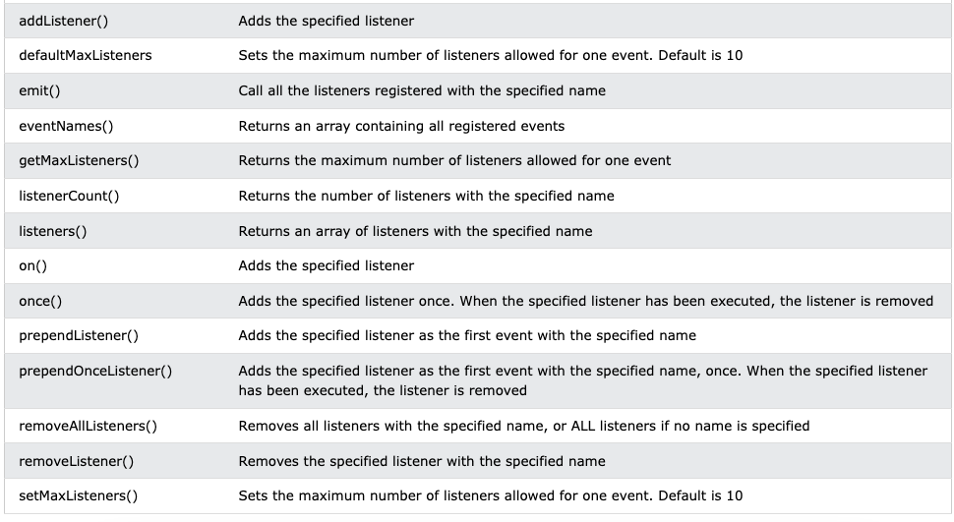
Methods And Properties
TASK : PERFORM ALL THE BELOW GIVEN EVENTS

Slide 7
Timers
The Timers module provides a way scheduling functions to be called later at a given time.
The Timer object is a global object in Node.js, and it is not necessary to import it using the require keyword.
The timer module exposes a global API for scheduling functions to be called at some future period of time. Because the timer functions are globals, there is no need to call require('node:timers') to use the API.
The timer functions within Node.js implement a similar API as the timers API provided by Web Browsers but use a different internal implementation that is built around the Node.js Event Loop.

Slide 8
Example
Problem : Write "Hello" every 500 milliseconds:
Solution:
var myInt = setInterval(function () {
console.log("Hello");
}, 500);

Slide 9
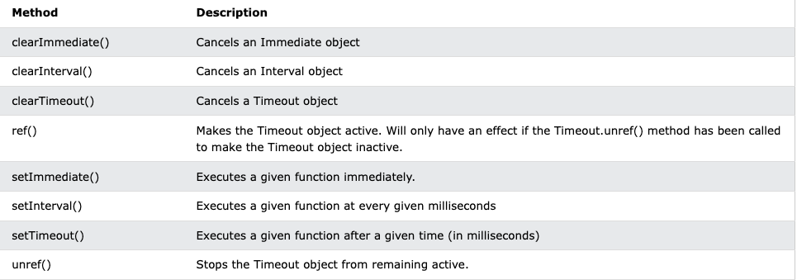
TASK : PERFORM ALL THE BELOW GIVEN TIMERS

